Slide 1
Individual Homework
Boolean Functions
Exercise 6.2
Using Quine’s method, simplify the following Boolean functions given in DCF (disjunction of minterms):
f₂(x₁, x₂, x₃) = m₁ ∨ m₂ ∨ m₄ ∨ m₅ ∨ m₆ ∨ m₇
Creț Valentina Andreea
Group 912

Slide 2
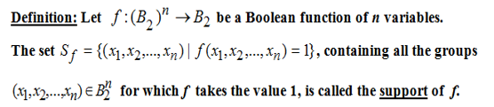
THEORETICAL RESULTS
Quine’s method

Slide 3
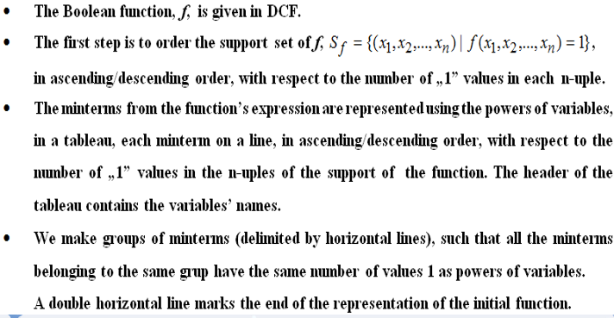

Slide 4
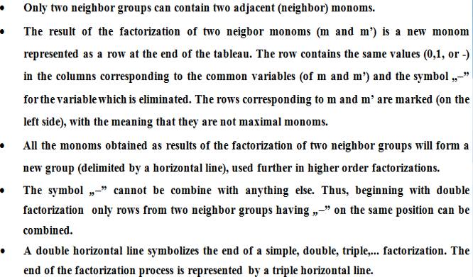

Slide 5
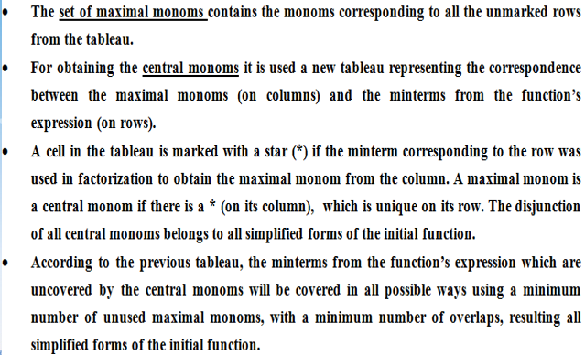

Slide 6
f₂(x₁, x₂, x₃) = m₁ ∨ m₂ ∨ m₄ ∨ m₅ ∨ m₆ ∨ m₇
= x₁⁰ x₂⁰ x₃¹ ∨ x₁⁰ x₂¹ x₃⁰ ∨ x₁¹ x₂⁰ x₃⁰ ∨ x₁¹ x₂⁰ x₃¹ ∨ x₁¹ x₂¹ x₃⁰ ∨ x₁¹ x₂¹ x₃¹
= x̅₁ x̅₂ x₃ ∨ x̅₁ x₂ x̅₃ ∨ x₁ x̅₂ x̅₃ ∨ x₁ x̅₂ x₃ ∨ x₁ x₂ x̅̅₃ ∨ x₁ x₂ x₃
S_{f} = {(0,0,1), (0,1,0), (1,0,0), (1,0,1) , (1,1,0) , (1,1,1)}
- Sorted in ascending order, with respect to the number of “1” values in each triple

Slide 7
Group | x₁ | x₂ | x₃ | Reprezentation / factorization
Ⅰ | 0 0 1 | 0 1 0 | 1 0 0 | m₁ m₂ m₄
Ⅱ | 1 1 | 0 1 | 1 0 | m₅ m₆
Ⅲ | 1 | 1 | 1 | m₇
✓
✓
✓
✓
✓
✓
- 0 1
= max₁
m₁ ∨ m₅ = x̅₂ x₃
Ⅳ = Ⅰ + Ⅱ
= max₂
- 1 0
m₂ ∨ m₆ = x₂ x̅̅₃
Simple factorization
m₄ ∨ m₅ = x₁ x̅̅₂
✓
1 0 -
✓
1 - 0
m₄ ∨ m₆ = x₁ x̅̅₃
Ⅴ = Ⅱ + Ⅲ
✓
1 - 1
m₅ ∨ m₇ = x₁ x₃
✓
1 1 -
m₆ ∨ m₇ = x₁ x₂
Double factorization
Ⅵ = Ⅳ + Ⅴ
1 - -
= max₃
m₄ ∨ m₅ ∨ m₆ ∨ m₇ = x₁

Slide 8
M(f) = {max₁, max₂, max₃}
Maximal monoms/ minterms | max₁ | max₂ | max₃
m₁
m₂
m₄
m₅
m₆
m₇
max₁ = m₁ ∨ m₅ = x̅₂ x₃
max₂ = m₂ ∨ m₆ = x₂ x̅̅₃
max₃ = m₄ ∨ m₅ ∨ m₆ ∨ m₇ = x₁
Օ
*
Օ
*
Օ
*
*
*
*
*
Օ
*
C(f) = {max₁, max₂, max₃}
M(f) = C(f) => 1st simplification case
There is a unique simplified form of f₂, obtained as the disjunction of all central monoms.
f₂^{s} = max₁ ∨ max₂ ∨ max₃ = x̅₂ x₃ ∨ x₂ x̅̅₃ ∨ x₁

Slide 9
Conclusion
The simplified form (using Quine’s method) of the Boolean function given is:
f₂^{s} = max₁ ∨ max₂ ∨ max₃ = x̅₂ x₃ ∨ x₂ x̅̅₃ ∨ x₁

